Slide 1

LESS
The Dynamic Stylesheet Language

Slide 2
Table of Contents
LESS Overview
Working with LESS
Using LESS
On the Client
On the Server
LESS Features
Selector nesting
Mixins and Functions
Variables and Interpolation

Slide 3

LESS Overview
What is LESS?

Slide 4
LESS Overview
Preprocessor to CSS
http://lesscss.org
Can be compiled both in the browser or the server
Using a LESS parser written in JavaScript
LESS Features include
Variables
Mixins
Color editing functions
Selector nesting

Slide 5
Working with LESS
Client and Server Side

Slide 6
Using LESS on the Client
LESS can be compiled in the client (browser)
Include a JavaScript file, the compiles it to CSS
Steps:
Write your LESS, download less.js
If using Visual Studio, you should add a mime type for the LESS in web.config
You are ready to go
<link rel="stylesheet/less" type="text/css" href="styles.less"/>
<script src="less.js"></script> //after the less link
<configuration> <system.webServer> <staticContent>
<mimeMap fileExtension=".less" mimeType="text/css" />
</staticContent> </system.webServer> </configuration>

Slide 7
Using LESS on the Client
Live Demo

Slide 8
Using LESS on the Client
How client-side LESS works?
The JavaScript performs a AJAX GET request to the LESS file
Then it compiles the LESS code into pure CSS
The CSS is appended to the HEAD of the page
Using client-side LESS is slow
All the compiling is done by the client
i.e. the browser spends recourses and time for the LESS compiling
Imagine a 2000-lines-long LESS file…

Slide 9
Parsing LESS on the Server
LESS can be compiled on the server
Using the client approach and copy the CSS
Not good enough, lots of copy-pastying
Using Node.js to do the parsing
Better solution - the parsing is automated
Using plugins for your favorite Web editor
Web Essentials for Visual Studio
LESS and LESS2CSS for Sublime Text

Slide 10
Compiling LESS on the Server
Live Demo

Slide 11

LESS Features
Selector Nesting, Mixins, Variables, etc…

Slide 12
Selector Nesting
LESS introduces selector nesting
body {
font: normal 16px arial;
color: #fff;
background-color: #011b63;
h1 {
font-size: 2.3em;
font-weight: bold;
}
}
body {
font: normal 16px arial;
color: #fff;
background-color: #011b63;
}
body h1 {
font-size: 2.3em;
font-weight: bold;
}
Compiles to

Slide 13
Selector Nesting (2)
All selectors inside a selector are translated to nested selectors
Selectors can also reference themselves inside their selector using the symbol & (AND)
body {…
h1 {…}
}
body {…}
body h1{…}
…
a{
&:hover{…}
}
…
…
a{…}
a:hover{…}
…

Slide 14
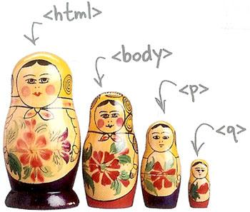
Selector Nesting
Live Demo

Slide 15
LESS Variables
LESS also has variables
Using the @ (at) symbol
Can be used to store colors, size, etc…
Usable to set default background color, font color, font size, border, etc…
@link-color: #ffffff;
@v-link-color: #646363;
a {
color: @link-color;
&:visited {
color: @v-link-color;
}
body a {
color: white; }
body a:visited {
color: #646363; }

Slide 16

Variables
Live Demo

Slide 17
Interpolation
LESS variables can be inserted as CSS properties
Using @{variable_name}
Usable with mixins
@border-side:top;
@border-color:blue;
@border-style:ridge;
@border-width:15px;
…
border-@{border-side} :
$border-width $border-style $border-color;
border-top : 15px ridge blue

Slide 18
Interpolation
Live Demo

Slide 19
Functions
LESS support predefined functions
For operations with colors
For sizes (percentages)
Find all the functions at http://lesscss.org/functions/
@color: #ffffff;
background-color:lighten(@color);
color:darken(@color);
percentage(0.5); //returns 50%

Slide 20
Functions
Live Demo

Slide 21
Mixins
Mixins are kind of developer defined functions
Used to extend abstraction and repeating code
Two kind of mixins
Parameterless
Get a the same styles every time
With parameters
Get style based on some parameters
Gradient, borders, etc…

Slide 22
Mixins (2)
How to define mixins?
Use .mixin-name
Then the styles are normal LESS
.clearfix{
zoom:1;
&:after{
display:block; content:"";
height:0; clear:both; } }
How to use the mixin?
Place use .mixin-name
ul#main-nav{
.clearfix;
}

Slide 23
Basic Mixins
Live Demo

Slide 24
Mixins with Arguments
Mixins can also be defined with parameters
i.e. for gradient-background
Use the arguments like a C#/JS method
.opacity(@value){
…
}
//arguments can take default values
.box(@border:none,@bg:rgba(0,0,0,0.7),@size:200px) {
…
}
…
div.box-div{
.box; //using the mixin with default parameter values
.opacity(0.5); //using the mixin with 0.5 value
}
…

Slide 25
Mixins with Arguments
Live Demo

Slide 26
LESS
http://academy.Telerik.com

Slide 27
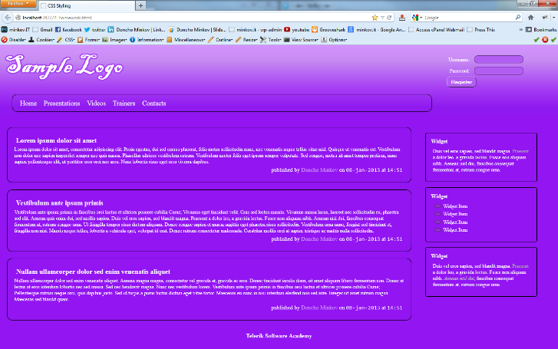
Homework
Implement the following using either LESS or SASS
Use the HTML code from homework.html
Create the LESS/SASS easy to change (colors, fonts)
Use mixins for clears, gradients)
Source can be found in Preprocessors-homework.zip

Slide 28
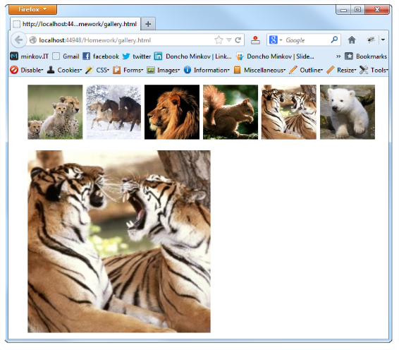
Homework (2)
Create a web gallery
Use only HTML, LESS or SASS
List images
When a image is selected, show it zoomed

